Slide 1
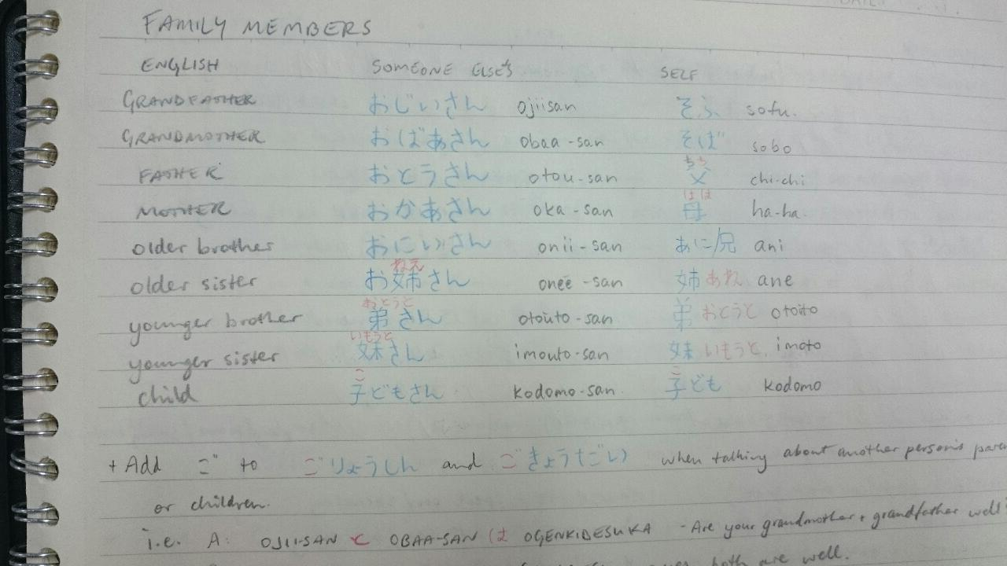
CLASSROOM TO COMMUNITY:
COMMUNICATING AND NETWORKING IN JAPAN

Slide 2
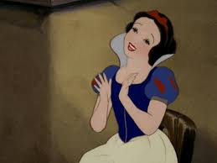
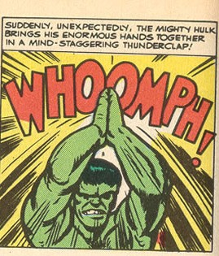
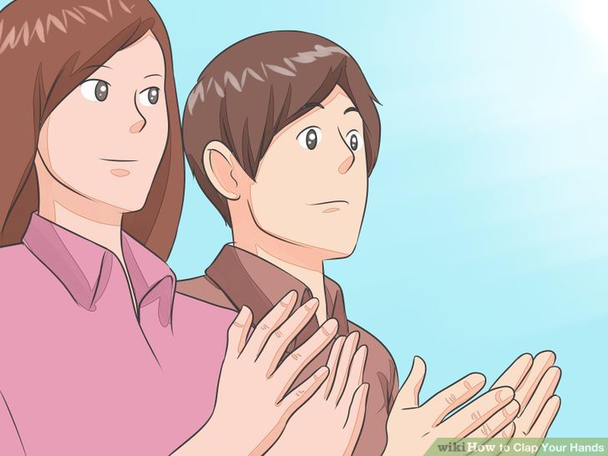
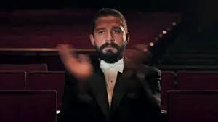
Survey
Notes:
2. First year ALTs.
3. Second year ALTs
4. 3/ 4/ 5 year
5. City ALTs / Country ALTs / between city and country/
6. Australian ALTs, NZ ALTs
7. Beginner Japanese Level / Intermediate Level / Advanced Level
8. Under 25 years old / between 25 and 30 / Over 30 years old
9. Enjoys Study / Doesn’t enjoy Study
10. Has made good connections with people in japan already
11. If you want to have more involvement with the community
12. If you want to learn a few tips and tricks for networking and communicating

Slide 3
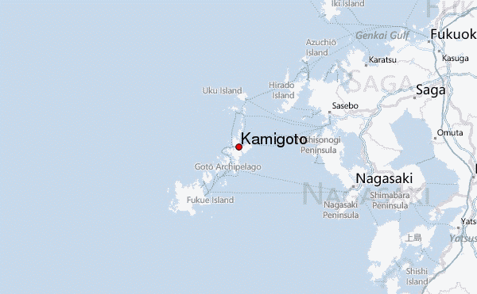
Notes:
About me. From Kamigoto, small population, I teach high school english communication at two schools, 5 ALTs on the island and it has been easy to meet a variety of people in a small population.

Slide 4
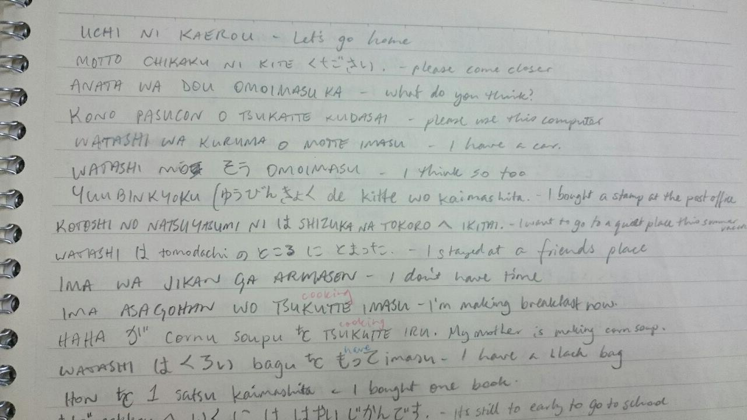
Purpose:
To improve our communication thinking to take advantage of the community around you.
2. To consider what works best for you in developing your own communication skills
Think about what you are saying!
Notes:
I’m going to share some stories, perspectives and examples of the journey I have been on in Japan, and how communication has made my job easier and allowed me to connect with more people, creating a network of people to learn from.

Slide 5
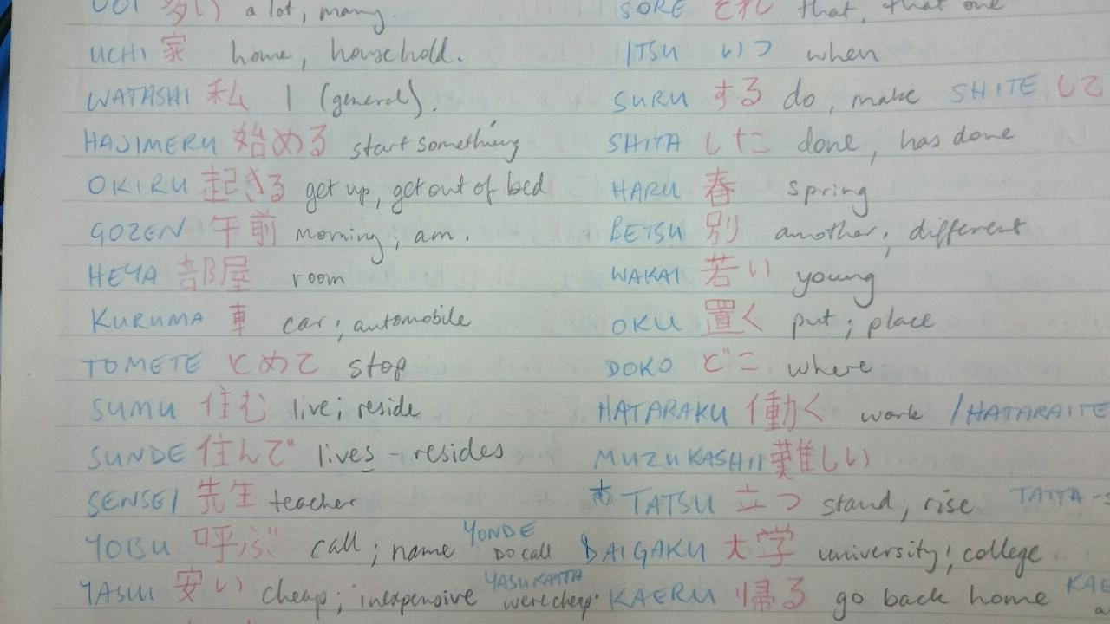
Today’s Contents
1 Self Introduction – Jiko Shoukai
2 Concept of Mastery
– the teaching philosophy to understand purpose in what you do
3 Communication techniques
4 Representing from Abroad
Notes:
We will talk through the Jiko Shoukai, and the effect it has on you, the concept of mastery and how you can use that for everything, a few communication techniques I want to share, and stories about representing from abroad, and how that makes you interesting.
I don’t want to tell you thinks you already know, which is why I did the survey at the beginning, so I better know who im working with. If there is something in this presentation that you already know, please think of it as a refresher, and think how you would explain it better from your perspective to others.

Slide 6
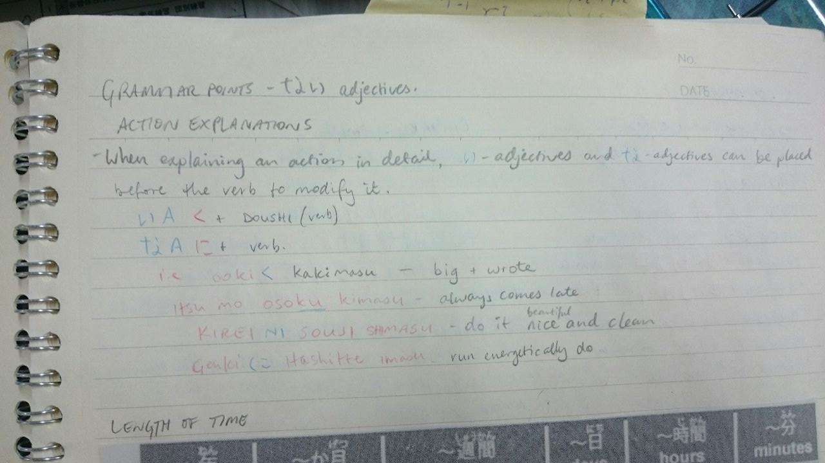
Self Introductions
Example of a Jiko Shoukai :
Hello my name is Anthony.
I come from Australia. I teach English at High School.
I enjoy playing soccer and studying communication with students.
My Name - Where I am from - What I do for the school/here in Japan
Leave room for further questions from your listeners, if they want.
Opportunity to connect to the listener, and have common interest. Leaving an opportunity for the listener to ask more questions
Notes:
What can be remembered from a simple introduction? Who is good at remembering names? Who is terrible at remembering names? Thanks for the extra survey results. It takes a while to remember someones name, but if you can say that persons name 3 times in a short amount of time, say 10 seconds from the introduction, you have a better chance of putting them in your memory. You heard from the survey just now that a lot of people are terrible with names, so teach people your names with association. People will respect you for remembering names. Especially if it’s a difficult name or foreign names. People who constantly have their name said incorrectly will respect you even more, and you:ll see this.
Its important to like things that others like and fit in. One time I was driving two staff members home after a party, and they asked me what I do in my spare time. I said I watch youtube, play online games with friends, and cook. I asked them both what they do with their spare time, and they both said ‘Study and more work’. Which of us looks more accountable for the job we do? From then on, I said ‘I spend time studying and communicating’, reflecting on what I do at home, and that brought about more study and communication at home, rather than the latter.
Keep a simple introduction that connects, and gives room to ask for more. If this is your introduction, what is a follow up question someone will ask?

Slide 7
Self Introductions
The 5 Questions everyone asks you.
Do you have a girlfriend/boyfriend? or Are you married? (relationship Q)
How long will you stay in Japan? When did you come to Japan? (Time Q)
Do you like the features/food in our town? ‘do you like sushi?’ (Current Location)
Where in your country are you from? (previous Location)
? (give me the 5th question)
The most common information is requested, to build an image or profile of you.
Think of a job interview, and what your prospective employer wants to know about you in a short amount of time, and why they want that info

Slide 8
Self Introductions
How to Answer, for best effect.
Relationship Q –
Time Q –
‘do you like sushi?’ (Current Location Q) – I like fried fish more/Saba is delicious.
Where in your country are you from? – the east coast of Australia, Brisbane. 1000km north of Sydney.
?
Give the most common information back, for their profile of you, so there is interest to build or gain from knowing you.
Notes:
Relationship Q – Say maybe, it’s a mystery, or I often say ‘soon’ or ‘not yet’. Saying no doesn’t make you feel good about the question, and you probably don’t want to person asking you this question asking any more relationship or personal questions.
Time Q – Say you want to stay, or don’t limit yourself. I:ll tell a person I want to stay forever and learn as much as I can about the island life and make as many friends in the community.
Do you like sushi – yes. Learn your favourite fish. Steal someone elses answers. Ask your JTE what their favourite sushi is, and steal their answer and use it for other people. Maybe you like saba or suzuki from now on.
Where are you from –

Slide 9
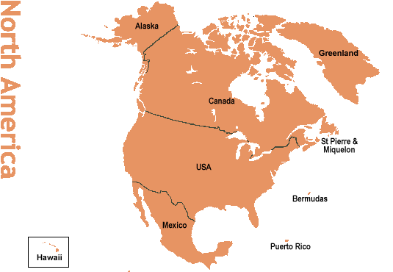
Notes:
This is what australia and America is to Japanese people. Do you know where Asahikawa is in Japan? They probably don’t know where you are from either.
Generate discussion about your country, and if you don’t know the answer to a question, look it up for next time! Build on your knowledge.
How much of Australia is desert?

Slide 10
Self Introductions
Summary
You will be doing self introductions often while here.
Be simple, provide basic information, give the opportunity to know more.
Ask the same questions back, show equal interest.
Think about what a textbook would include for an English self introduction
Learn a simple self introduction, so that you can also do it in Japanese.
Give mystery, represent yourself and all foreigners, develop and change your self introduction learning as you go.

Slide 11
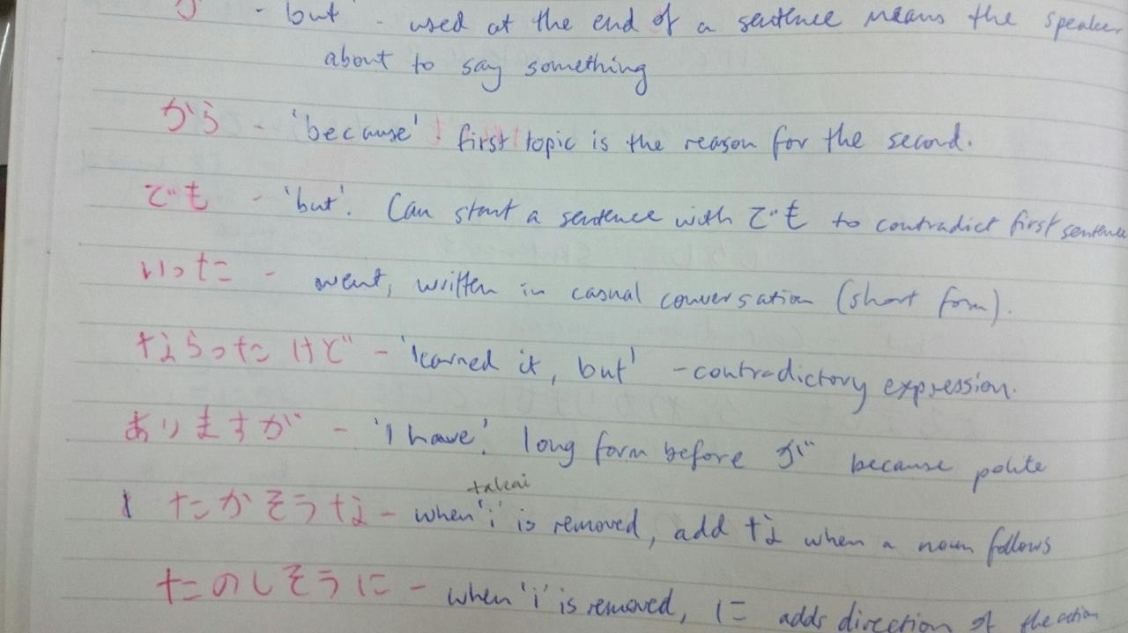
THE CONCEPT OF MASTERY:
The Teaching Philosophy to understand purpose
The concept of mastery means:
You are good enough at something that you can teach it to others.
You have both the attitude and social awareness of what you are doing in your place in society.
Notes:
This translates to many definitions in different cultures and professions, and I first learnt about it from a bruce lee book, so there was plenty of inspiration to come from it, and I learned more about it. Studying to become a teacher, lifelong learner principle suggested this concept, but its important to what I have learned so im including it here. Many teachers and good role models in my life demonstrate this concept of mastery, and it is a lifelong process. Think about who you want to teach your skills and understands to in the future. Possibly your own children, so they have a life different to yours,

Slide 12
THE CONCEPT OF MASTERY:
The Teaching Philosophy to understand purpose
The concept of mastery applies to you as a JET in many ways.
You are an adult, you work with students/young people.
You teach English, and practice Communication in Japan
You are facilitating cultural exchange between your home country and Japan
Notes:
One day you will have someone else take over your position in your school, just like you took over from someone else. What sort of standard to you want to leave for the next to take over? This will apply to so many other facets of your life, being your future job roles, family and the people you work with. It’s a continuing cycle of skill development, and if you understand the concept, and you aspire to have enough knowledge to pass on to others, you are a teacher above classroom learning, and you can encourage others to learn the mastery.
This is also a motivational aid to give more purpose to what you enjoy doing most in life.

Slide 13
THE CONCEPT OF MASTERY:
Quick, small group activity
Using communication
Short Story
Who was your first friend in elementary/primary/grade school?
How did you meet? Share the story
-2 Minutes-
Notes:
14 mins to here

Slide 14
Make a group of 3 or 4, two desks, desk in front or behind. Like the game Telephone. One person in the group will tell the story.
Story teller
Next Person Listens
Repeats the story and adds opinion
3rd and/or 4th person Listens to the repeated story and opinion, shares it back to the original story teller
Notes:
Group of 3-4 people. First person shares a story to the second person. Second person shares the story to a third person, and says what they think about the story. Third person passes the story back. Don’t listen in, and think about what is being said at each stage as the story passes. You have 2 minutes.
First person might say, I met my first friend in primary school because we had the same interest in kicking footballs and teenage mutant ninja turtles. Next person might say ‘this person made friends with others because of sports and the show teenage mutant ninja turtles’ the last group will reply to the story teller and say ‘I hear you make friends with people who like sports and cartoons’

Slide 15
THE CONCEPT OF MASTERY:
The Teaching Philosophy to understand purpose
What was not said? What did you expect to hear?

Slide 16
THE CONCEPT OF MASTERY:
The Teaching Philosophy to Understand Purpose
Lesson Learned:
People will do this with your story. Repeat it, and challenge the understanding.
No one really knows you, but they know the opinion of you.
What you say matters, so think about what you are saying. It’s easier when you are communicating with non-English people, and that’s where you learn how to control your communication.
Notes:
No one really knows each other, but the opinion we form of others becomes critical. If you can understand how this happens, it can make you better understand social situations. I have learned about how judging people, and people who judge, don’t really make good connections. They just get better at judging others. The old Rumi quote, ‘Those who want perfect friends, get no friends’.
Or the quote, great minds discuss ideas, average minds discuss events, small minds discuss other people.

Slide 17
THE CONCEPT OF MASTERY:
The Teaching Philosophy to Understand Purpose
Applying the concept of mastery to communication and networking:
What would you say to someone knowing that you could expect criticism the way this activity challenged? How would you answer if you could try it again?
How do you answer a question about yourself and your ability so that you get the criticism you want?
What would you teach a new ALT next year about their self introduction?
Notes:
Have you ever said something in conversation, then thinking about it later, you realise you could have had said something much better? It’s a universal feeling, and this activity is suppose to make you feel that. Lessons and examples like this made me consider what I was saying. My mother and father and a lot of people around me growing up would always tell me to think about what I was saying, and it was because I lacked maturity. It just takes time with some people. Thinking about the grammar we use in language also makes you more considerate of what is being said, and the direction of the information you give.

Slide 18
THE CONCEPT OF MASTERY:
The Teaching Philosophy to Understand Purpose
Applying the concept of mastery to communication and networking:
Have a positive or neutral approach to the information you give.
Look for common ground, especially if someone is answering your questions.
People always compare other people to themselves, because we know what we like.
Share and use the opinion of others, proving their communication ability is helpful and worthwhile.
Notes:
Try and give an example for one or two of the above.
Know straight away what is the negative response, and avoid it. Is Kanji difficult to learn? No, its interesting.
Sharing the things you like. Agree with people, show agreement etc.
One of the only reasons you are going to like someone on different levels, including friendship levels, is because you think someone is like you. We both like the same food and music.
I went to the supermarket after 6.30pm like you said, and bought half price sushi and it was awesome. Thank you. Let others know they are helpful.

Slide 19
THE CONCEPT OF MASTERY:
The Teaching Philosophy to Understand Purpose
Applying the concept of mastery to communication and networking:
Negative people and responses
Two negatives make negative conversation.
Negative responses don’t always make people want to talk to you.
Understand why you give negative responses
Some people thrive off negativity, and that’s their thing.
Notes:
Ive been asked why people in my home country are so fat. Eating styles, and the types of food. Its something i:d like to talk about, and compare. I will make a negative conversation like that an interesting conversation. Aren’t sumo wrestlers considered attractive for their awesome girth?

Slide 20
THE CONCEPT OF MASTERY:
The Teaching Philosophy to understand purpose
Repeated
The concept of mastery means:
You are good enough at something that you can teach it to others.
You have both the attitude and social awareness of what you are doing in your place in society.
Notes:
21 minutes

Slide 21
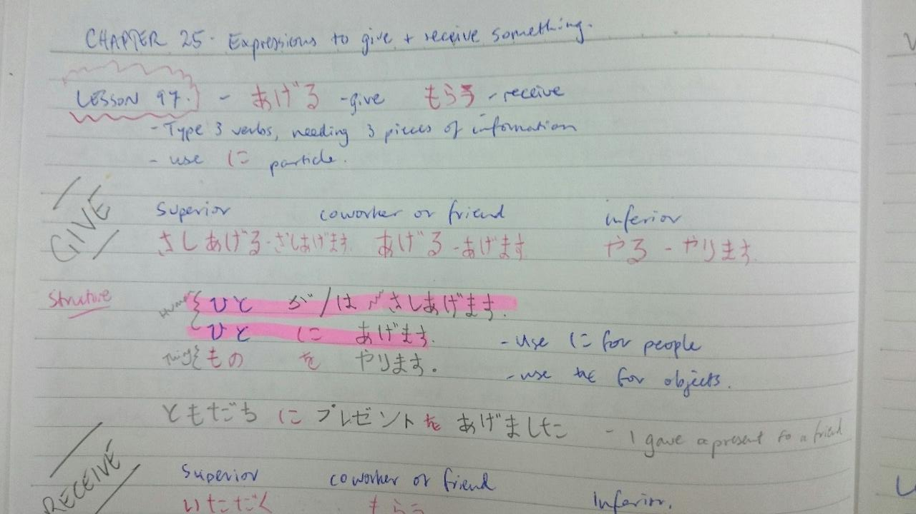
Communication Techniques
Things I do and have learned communicating in Japan
Notes:
Prior to coming to japan, all of the jobs ive had require strong communication that ive learned from many mistakes. First being a school teacher, always being a football/soccer referee and working in government jobs with senior executives. I don’t like saying that I teach english, particularly because its not a popular subject in a country school, instead I say I teach communication. There is a lot you can learn about the japanese language from learning english, and im learning plenty about english from studying japanese.

Slide 22
Communication Techniques
Listening is more important than speaking. (story of previous boss and role model)
Refrain from thinking ahead, stay quiet, repeat back, show that you are listening (eyes)
Use this with JTEs and other school staff.
Notes:
I worked in local government in disaster operations. My boss was previously an advanced naval warfare officer from the navy, so he had unique skills for crisis communication and high level operative communication for controlling ships loaded with missiles and human lives among other things. When he would listen to you, his eyes would move rapidly to follow your text, and his face would show the information I was presenting him being absorbed. He could reply simply, and fantastically to everything. His listening was so powerful and presented, it made me want to be a better listener.
Speaking, like I am now, gives you the satisfaction of hearing your own voice. But listening, you need to react and make results

Slide 23
Communication Techniques
Don’t say ‘no’ (being polite in Japanese).
‘No’ is rejection, dismissal, disrespect, disowning ideas and initiatives.
Learn from the Japanese way of saying no. ‘I’ll get back to you’
Just be honest, and further the suggestion.
i.e. Do you want to come shoe shopping with me all day in Hamamachi?
‘I’d love to, but there is something else I need to do with that time.
I could meet up with you after?’
Notes:
Story about meeting Kumi. She worked for a wedding agency, so was very polite. We continue as friends today, and I learn constantly from her communication about being polite and respectful in conversation.

Slide 24
Communication Techniques
Know when you are talking about yourself. Using ‘I’, ‘me’, ‘my’
Change in your conversation to talk about ‘us’ and ‘we’ and what you are doing.
Consider this when writing an email.
Too much emphasis on yourself shows you think too much about yourself
Open up the conversation to know more about the other person or people you are with
Notes:
I want this presentation to be as much about experiences worth sharing with you. As often as possible, im sure you are sharing your experiences with friends and family back home, maybe other ALTs. Ive seen presentations in a previous role where a senior executive was showing photos of his boat and 4-wheel drive to us, and it was awful. Instead, I talk and share my experiences and considerations, because it what I want you to learn from and make your own. Be influential in your communication style.

Slide 25
Communication Techniques
Control awkwardness. Recognising awkwardness is / can be situation control and power in communication.
Crowd work.
This happens to students in the classroom.
This has happened to you your whole life.
Notes:
Crowd work. Point out someone in the crowd. Say that they look exactly like my sister, and for that reason, we cannot be friends. Being put on the spot creates awkwardness, and this can be done to you, or you can do it to others. If you can recognize awkwardness being created, you can have control of communication.
Silence can be awkward, but knowing the power of silence, you can take it somewhere. If im in a silent situation, I change the environment first.

Slide 26
Communication Techniques
Networking. Introduce people
The best thing you can do is introduce someone and say what they are good at or how/why you know them. This makes you look good being able to do this, because you are creating a network.
What would you say when introducing your Koucho Sensei or JTE?
Story about Senpai doing a poor introduction.
Cupid Effect. Could you introduce two people to make a marriage?
Notes:
Senpai introduced me to someone and said this person has no girlfriend. It was an awful introduction. I corrected him and said that he could have said that the person would make a great partner, and hes the nicest person around here. Talking other people up is respectful to both you and the receiver. Not many people do this, and it is an art to do it simply without over flattering the person.

Slide 27
Communication Techniques
English mode and Japanese mode
Use your ability of English as a communication skill, if you don’t have any Japanese. (Soft Tennis Story).
Use the Japanese you are learning. Practice your textbook skills, point out Kanji you can recognize as you are learning it.
You are both a teacher and a learner. All teachers are. Teach me Japanese. (this is what the students taught me in the first 2 months)
Notes:
(Can cut this slide, and the next that supports it)
English Mode and Japanese mode means knowing when to use english or your foreign ability contextually.
Soft tennis story. I am surrounded by seniors while playing soft tennis on Friday night. They will try and use the basic english they know. ‘very good’ etc. One time a student from high school joined. While they were giving feedback in Japanese, I added afterwards some feedback in english, something no one could understand because of the language barrier. But the attitude and the body language I used gave them hints to what I was saying, and they knew it was the same thing but in english. My point was to prove communication is similar, language is different, and to be english at the appropriate time.
Show you are one of the group, outlast. I cannot drink like Japanese people drink. I usually switch to ocha after the first 2 beers. I will listen to conversations in izakayas with my teachers until past the time I really want to go home, and I can enjoy the company I am with, despite not being able to understand them. I wouldn’t have done this back home in australia. It’s a new environment, its time and the place to experience this way of life.

Slide 28
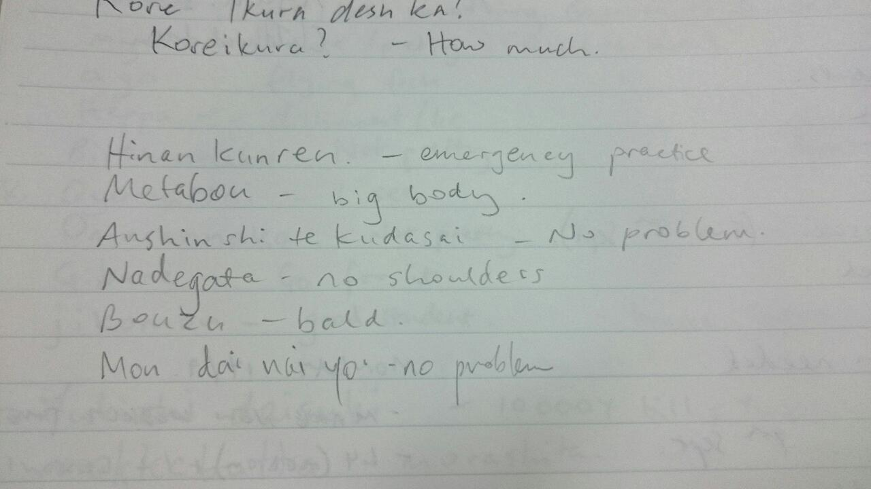
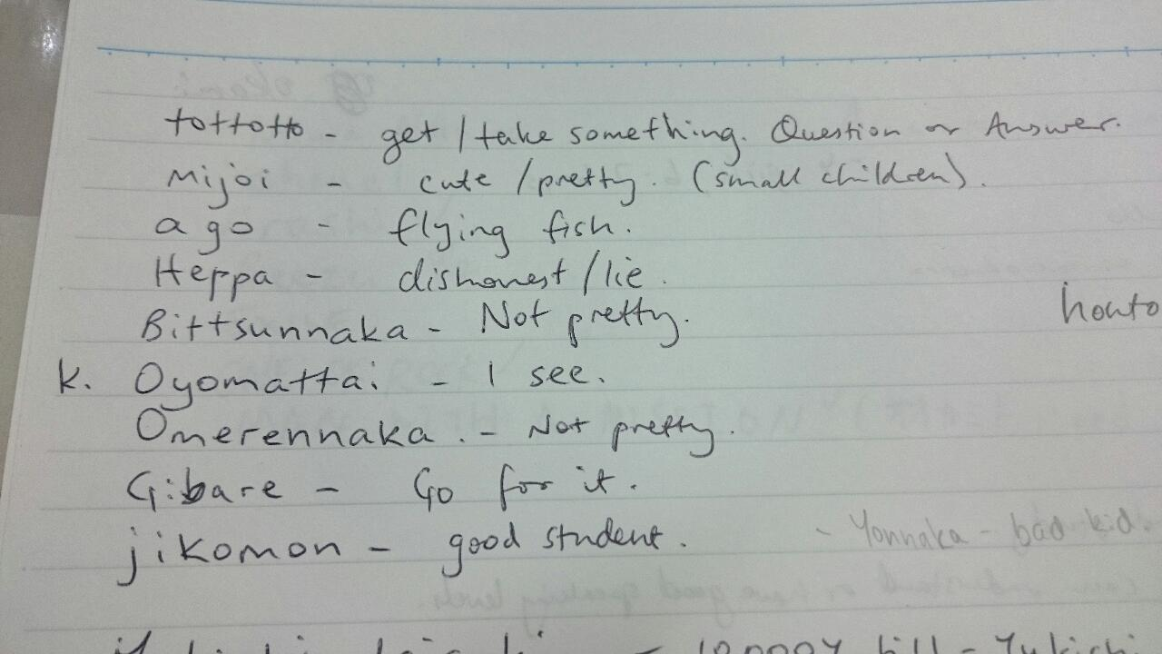
Notes:
I asked students to teach me Japanese, and they taught me what is wrong with my body shape.

Slide 29
Communication Techniques
Recognise the abilities of those around you, and learn from them.
Good teachers are hard to find
Ask ‘teach me how to…’ and say ‘I want to know more..’
Keep good friends and communication with those who are good communicators with you, and promote good communication.
Learn from older experienced people / people who want to share knowledge with you
Notes:
All students have a hobby or club they belong to, and often the love for that activity stays with them for life. Teachers who were awesome at volleyball become volleyball teachers, etc. Use them for what you want to learn, and can share learning with.
Choose one teacher in the staff room and use them as a role model for your dress code. Not too much, not too casual.
Ask google, wikipedia, youtube before you ask your JTE or kyoto sensei. What is Setsubun? Wikipedia it, and then tell them you know. Think about the questions you are going to ask and if you can find it elsewhere. Google and Wikipedia should be your best friend while here.

Slide 30
Communication Techniques
Summary
Think about what you are saying, build on it.
Use the environment and the people in your community.
Mentors and teachers are very important, promoting the concept of mastery, and the way for you to get into society outside of school.
Promote the people around you
Use your English, use other peoples English, get Japanese.

Slide 31
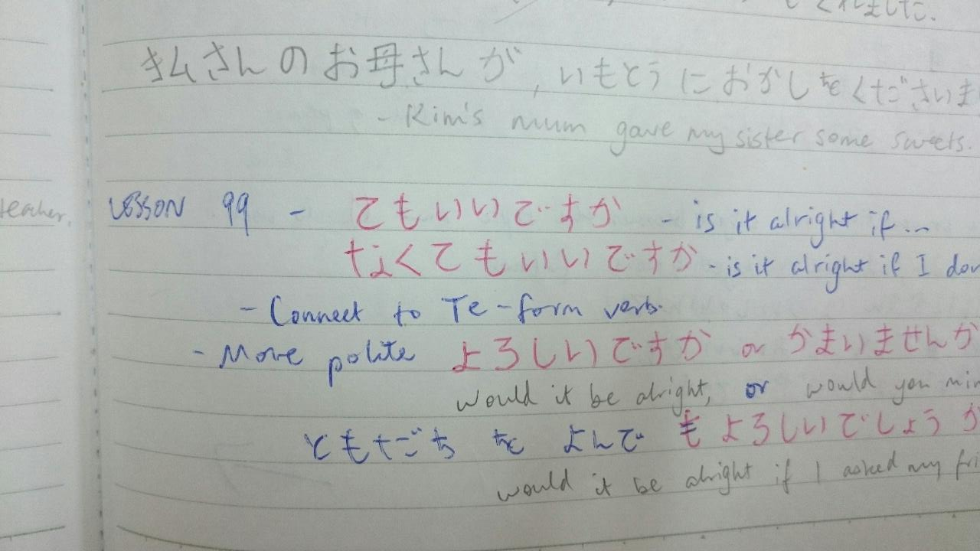
Representing from Abroad
Notes:
In this chapter I want to talk about using cultural differences to benefit, and by being naturally unique because of peoples impressions of your home country.
Often you might be seen with the same eyes that judged your predecessor, and people easily expect you to be the same. It happens with young people in the workforce in Australia. A company hires a 20 year old intern, they do nothing and ask a lot of questions and request a lot of holiday time off, so all other young people entering that company get painted with the same brush.

Slide 32
Representing from Abroad
In the first few months I didn’t have a good connection with the people around me.
I wanted a connection, something new and something familiar.
I thought about how to do it.
I took opportunities and seized the initiative
- Story of fitting in.
Notes:
One school was better than the other. I didn’t want it to be like that. I didn’t feel good connections with my JTEs. But at lunchtime, I was sitting with a group of teachers that were trying their investigative english on me to find out more about where I come from, what my interests are. Food, hobby, sports etc. I built up with these teachers, went fishing, played tennis, and spent the time with them to be respectful, considerate and good at compromise, being someone who listens, someone who is different, and someone who can relate. Because of my connection with those in my team who wanted a connection, their appeal towards me became the appeal of others, so the teachers who didn’t have a good connection to begin with saw the value that others had in me, and followed suit.

Slide 33
Representing from Abroad
People know you, you don’t know them.
Parents, people at the shops.
Use who you know to make more friends, get involved in other activities.
My story of being in soft tennis, volleyball with school, after school activities. Friends at the supermarkets, people that are a part of my routine.
– checkout-lady story
Notes:
You are automatically interesting to other people in Japan. Use the feelings they give you as an interesting outside to build your character and profile in Japan. Always be honest and dependable. Stay in contact, everyone has email (get a meishi business card from a local printing shop or vistaprint). Have the intention of making friends with people like its your purpose of being here in Japan. Ive seen on group facebook pages people who have been on the JET programme previously who are returning to Japan to see old work colleagues, students and friends they’ve made here. Let that be you in 10 years from now.

Slide 34
Representing from Abroad
Summary
Represent what you can be to the community
Keep it simple!
Learn from the mistakes of people before you and around you
Set the standard high for the people who will come after you
Notes:
Weatherwoman story – atartan@iinet.net.au

Slide 35
CLASSROOM TO COMMUNITY:
COMMUNICATING AND NETWORKING IN JAPAN
The Future
What would you present in the Classroom to Community workshop series next year, using skills gained in the concept of mastery, developing your communication and from experiences gained in the community?
Notes:
The classroom to community workshop will grow in the future for presentations next year. It was created this year with support and feedback from experienced ALTs and PAs, and some feedback from previous years events about what sort of information and presentations people wanted.
Take the time between now and next years SDC to think about what you would teach new ALTs, and what experiences you’ve had that could support all ALTs, how the concept of mastery applies to you in your environment and the things you do, and how you represent from abroad in Japan.
Take a question or two from the audience here.

Slide 36
Closing Activity
_____ of minutes remaining to complete this.
Discussion in groups regarding (choose any):
The opportunities you have taken so far
What you are doing to network in your community
What information you will use from this workshop to better your communication
What have you said in your introductions that work really well?
What communication skills do you teach to your students?
Discuss the challenges you’ve had representing abroad
Notes:
Identify any 3-5 year ALTs, and encourage them to walk around the different groups. If there is something unique, discuss it openly with the room.
Discussion is really up to the participants. I want you to continue this workshop using your own experiences to the people around you. Hopefully you’ve just met someone in this room and you can continue to grow with them in communication as colleagues in the JET community.

Slide 37
CLASSROOM TO COMMUNITY:
COMMUNICATING AND NETWORKING IN JAPAN
Your Summary
Notes:
What did you get out of this presentation? What questions do you have?

