Slide 1
Language Learning Myths
Joseph Salmingo, 2nd year Tsushima ES/JHS ALT

Slide 2
On many occasions, foreign language teachers base their practices on popular beliefs about language learning or they simply take the validity of previous practices for granted and teach as they were taught. Thus, they perpetuate practices whose effects on learning have not been tested empirically, or, have been tested but the results have not reached the hands of teachers, or, have been tested in laboratory conditions and the results cannot be extrapolated to the classroom.
“Should EFL Teachers Present Vocabulary in Semantically Related Sets?” – Ibarolla and Gordo, 2013
Notes:
-Why I chose myth as a talking point
-Why we teach the ways we do -During this talk, don’t just listen to me, if there is a topic you are particularly interested in, I urge you to look it up right now on your phone
-Caveat: Just because a myth is disproven doesn’t mean that it is 100% false. Continue to investigate the different elements of that myth

Slide 3
Myth #1: An native speaker is a better teacher of the language than a nonnative speaker
Notes:
-Prejudice worldwide towards native speaking teachers
-Where the myth was based off of
-Skill with the language may not constitute knowledge or the ability to teach it

Slide 4
Why should the native speaker be intrinsically better qualified than the non-native? This is presumably felt to be the case because of greater facility in demonstrating fluent, idiomatically appropriate language, in appreciating the cultural connotations of the language, and in assessing whether a given language form is acceptably correct or not.
“ELT: The Native Speaker’s Burden” Robert Philipson, 1991
The Native Speaker Fallacy
Notes:
-Putting the teacher in language teacher
-There are differences and tendencies by native speakers, for example, usage of vocabulary, being more lenient -If you are a nonnative speaker, you can still learn a lot of the language
-As native speakers we need to understand our language AND understand how to teach language

Slide 5
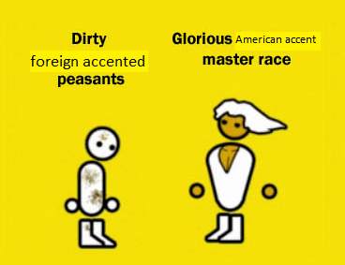
Myth #2: Pronunciation Training is Accent Reduction Myth #3: The most important part of Pronunciation is the Individual Sound (Phoneme)

Slide 6
Correlation of Accent to Comprehensibility by Native Speakers
Notes:
-Hard to draw correlation between whether someone can be understood and accent
-Based on this data, when we are in the classroom, and since pronunciation is often stressed by native speakers, when we teach we should focus on how to be understood and not working to hard to reduce accent

Slide 7
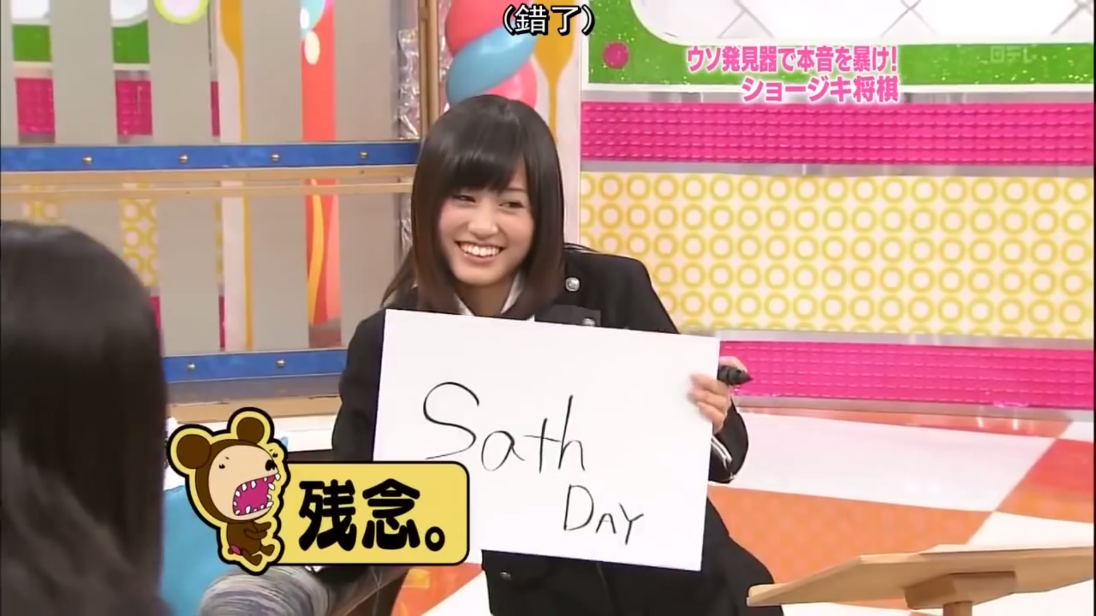
The gold standard for good pronunciation is being understood.
Phonemes, Syllables, Words
Intonation and Rhythm
Notes:
-Breaking down elements of pronunciation
-Phonemes are no longer considered the most important part of being understood -Some phonemes aren’t as important
-Syllables impacting Rhythm -Defining intonation

Slide 8
English is a Stress-Timed Language
Bob ate some corn.
Kenny has swum to France and back.
The Americans are buying some souvenirs and potatoes.
Notes:
-Rhythm

Slide 9
Myth #4: The best way to learn vocabulary is by writing it over and over.
Myth #4: The best way to learn vocabulary is by writing it over and over.
Myth #4: The best way to learn vocabulary is by writing it over and over.
Notes:
-Japanese students learning kanji
-Is this the best way to learn kanji?

Slide 10
Transcendence of Lexical Capacity
Awareness of what they’re learning
Awareness of a variety of methods and choosing what works for them in that moment
Systematic Learning
Notes:
-WTF is this title
-What are they doing with their method? What are they attempting to recall?
-Using different methods when appropriate. Anki/Word Cards, studying word lists, writing sentences, mnemonics
-Being consistent in acquiring new vocabulary

Slide 11
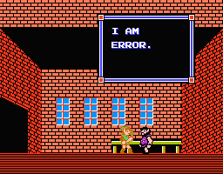
Myth #5: Strict error correction is the key to language learning
Notes:
-Teachers needing to correct, students thinking that correction is good

Slide 12
The key to learning
Notcing your mistake
Understanding your mistake
Correcting and reflecting on your mistake
Notes:
-Who is noticing the mistake? Would a student notice their mistake?
-If they correct, will they reflect on it?
-Is the correction easy to understand?
-”Noticing” is misspelled

Slide 13
Is Written Error Correction necessary?
Truscott “The Case against Grammar Correction in L2 Writing Class” (1996)
The paper argues that grammar correction in L2 writing classes should be abandoned, for the following reasons: (a) Substantial research shows it to be ineffective and none shows it to be helpful in any interesting sense; (b) for both theoretical and practical reasons, one can expect it to be ineffective; and (c) it has harmful effects.
Notes:
-This damning article called for the abolishment of written error correction
-Triggered many studies to analyze error correction
-Types of error correction
-Written: Prompting vs. Rewriting
-The perception of error correction being necessary

Slide 14
Some Error Correction Types
Recasting
Prompting
Notes:
-Understanding different error correction methods
-Which is more effective?
-Think about motivation

Slide 15
“Is repeating (behaviorism) a good language learning strategy?”
“How is input related to vocabulary?”
“How does a native speaker judge pronunciation different from a nonnative speaker?”
“How do I get comprehended vocabulary into vocabulary used in production?”
“Native speakers typically disregard the opinions and writings of second language researchers and rely almost entirely on their own intuition and previous teaching experiences. Such teachers see little or no value in improving either their teaching qualifications or their understanding of the field in general due to a perception that academic research and academic papers have nothing to do with what happens in the language classroom.”
Notes:
-We’ve went through a lot of myths. Some we still don’t have complete answers. Some have even brought on additional questions.
-From this talk I want you to understand that we take things for granted, and that tons of research is available for free online
-Do your research and ask questions. Don’t antagonize research as too theoretical and don’t rely simply on teacher experience.
-Thanks for listening.

Slide 16
References:
Myth #1: “ELT: The Native Speaker’s Burden” (1991), Robert Philipson
Myth #2: “Foreign Accent, Comprehensibility, and Intelligibility in the Speech of Second Language Learners” (1995), Munro and Derwing
Myth #2 and #3: Pronunciation Myths (2014), Brinton and Grant
Myth #4: Vocabulary Myths: Applying Second Language Research to Classroom Teaching (2004), Folse
Myth #5: Treatment of Error in Second Language Student Writing 2nd Edition (2002), Ferris

